Slide 1
PIRI REIS UNIVERSITY Faculty of Economics and Administrative Sciences Management Information System
YBS414 Enterprise Information Systems
Assoc. Prof. Dr. Batuhan Kocaoğlu
Kemalcan Ceylan 201735013
Arda Demirel 201735015
Can Kayacı 201735039
Topic(C): Develop a web based application using Vue.js, django, postgre. Host in Azure. Use git. Youtube link: https://www.youtube.com/watch?v=kR9AcRZiApE

Slide 2

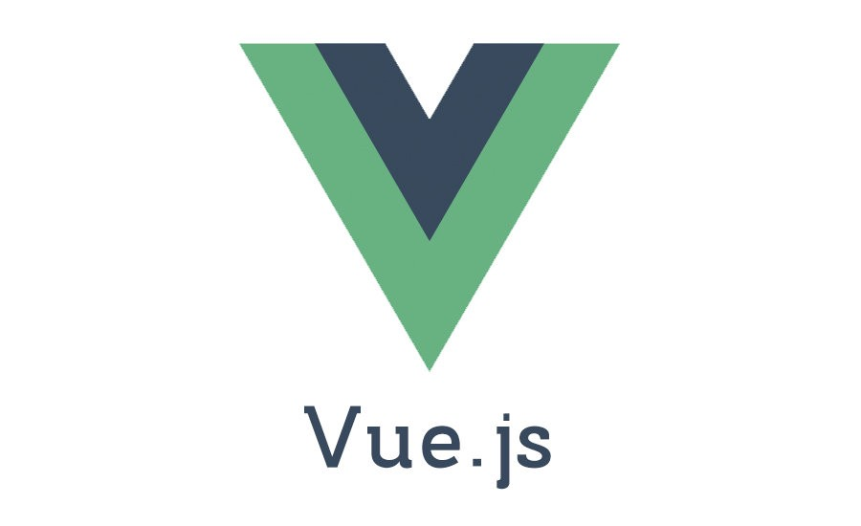
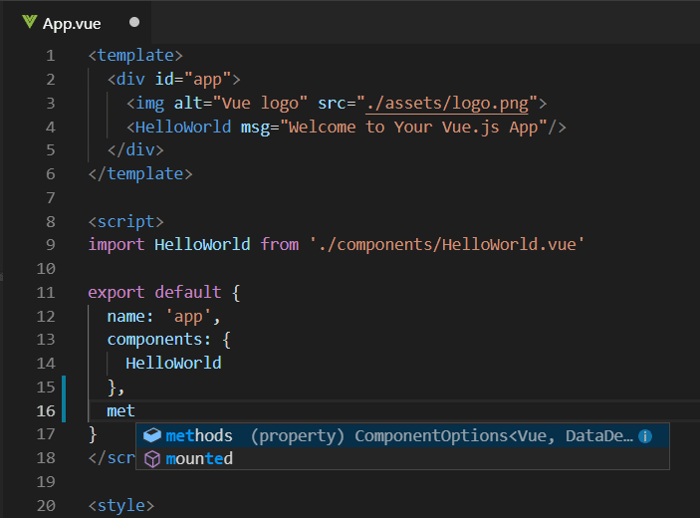
What is Vue.js?
Released by Evan You in 2014 to better "AngularJS", Vue.js is an open source Javascript framework, an interactive front-end library or framework used to build user interfaces and single page applications.
It has a progressively adoptable architecture that focuses on declarative rendering and component composition. Advanced features required for complex applications such as routing, state management, and building tools are officially available through supporting libraries and packages.
Notes:
https://www.nanomedya.com/tr/makale-detay/vue-js-nedir
https://ceaksan.com/tr/vue-js-nedir

Slide 3
Advantage of VUE.JS
One of the biggest advantages of VueJS is its size. The size of VueJS depending on the installed plugin is between 18-21KB. Its size-dependent speed is also much better than its competitors.
It provides easy learning with easy to understand documentation and simple syntax.
It allows you to produce different add-ons or different solutions depending on the situation of your project. It does not oblige you to include an application that you will not use in your project.
VueJS, which has a rapidly growing community, will be a very important advantage in finding answers to the problems you will experience during the development phase.

Slide 4
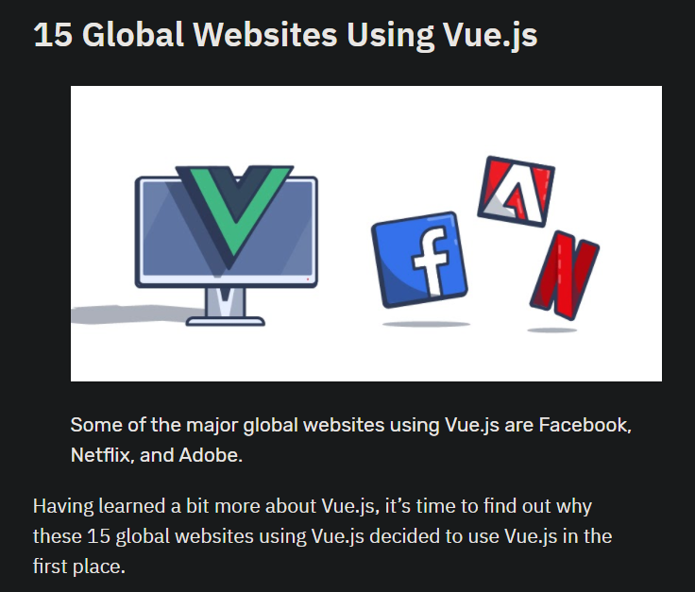
Websites Using Vuejs
Notes:
https://trio.dev/blog/websites-using-vue#:~:text=15%20Global%20Websites%20Using%20Vue,Facebook%2C%20Netflix%2C%20and%20Adobe.

Slide 5

What is Django ?
Released in 2005 and still being developed, Django is a high-level web framework for the Python Programming Language and licensed under a BSD license. It distinguishes itself from other server software and frameworks with its simple installation and use, detailed error report pages and new interface coding methods.
An object-relational mapping component that acts as an intermediary between data models (defined as Python classes) and a relational database within the application framework; a regular expressions based url dispenser; a view system for processing requests; and template system.
Its main goal is to facilitate the implementation of complex web applications that use a database.
It has a fast and easy software architecture, performs database and optimization functions. It allows you to generate a dynamic HTML structure.
Notes:
https://teknoloji.org/django-frameworku-nedir-avantajlari-neler/
https://coderspace.io/blog/django-nedir-neden-bu-kadar-populer/

Slide 6

Advantages of Django
Django is simple to install and easy to use.
It provides detailed error reports. It is easier to solve the problem easily among the errors given in detail.
Django bridges the gap between data model and database engine and supports a wide set of database systems such as MySQL, Oracle, Postgres.
Django is a framework that is at a very good level in terms of security.

Slide 7
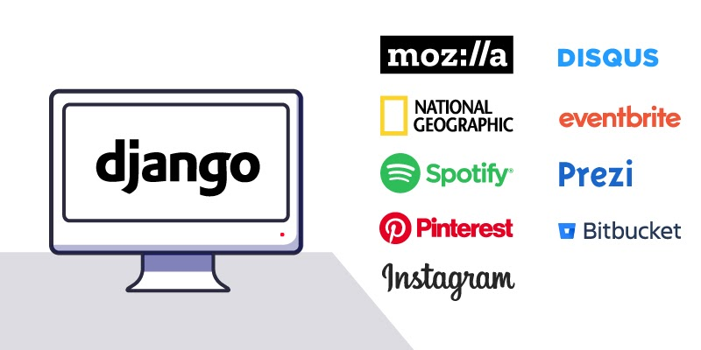
Websites Using Django

Slide 8
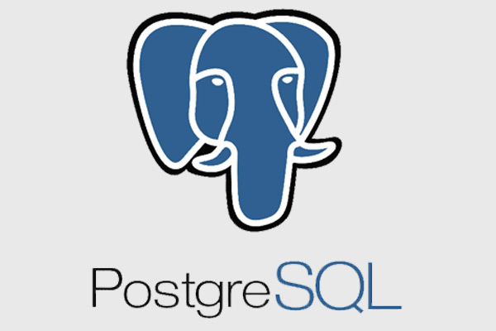
What is PostgreSQL ?
PostgreSQL is an open-source, platform-independent advanced object-relational (ORDBMS) database management system that is popular all over the world.
In addition to corporate database features that will compete with leading commercial database products, PostgreSQL has many new and innovative features compatible with today's digital transformation projects and technologies.
The PostgreSQL database and provides many innovative features that appeal to system administrators, architects and developers, and enterprises.
PostgreSQL is easy to learn, install, configure, manage, monitor and maintain. There are many management, monitoring open source and commercial tools in the PostgreSQL ecosystem.
Notes:
https://wmaraci.com/nedir/postgresql
https://www.pomelosoft.com/blog/postgre-sql-nedir

Slide 9

Advantages of PostgreSQL
It is economical, no license fee, gives you manufacturer independence.
You can install and distribute PostgreSQL on as many servers as you want.
PostgreSQL has a very advanced query planner.
It has drivers for all modern programming languages.

Slide 10
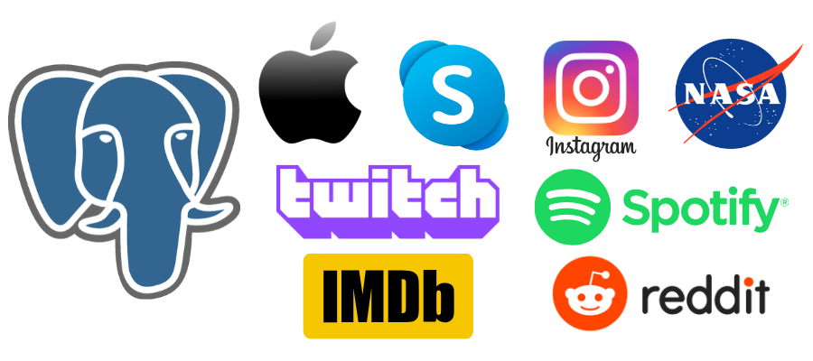
Websites Using PostgreSQL

Slide 11
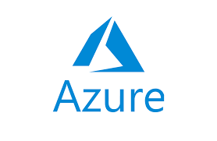
What is Azure ?
Microsoft Azure is Microsoft's infrastructure and cloud application development platform. This platform, on the other hand, enables the development of various internet applications that work with the internet and can keep their data on the Microsoft Data Center. If we wish, we can keep the data of this application we have developed within our own institution and make it work on the cloud.
Microsoft Azure is Microsoft's cloud solution that offers different platforms at all stages from developing an application on the internet, from hosting that application to storing, publishing and running, and guaranteeing data privacy and security while doing all this.
The interface used primarily to manage Azure is called Azure Management Console. This portal provides the ability to manage the Azure structure over the internet by connecting it with another web browser. It can also create virtual machines with the management console. You can publish websites and do data management as well.
Notes:
https://www.mshowto.org/microsoft-azure-nedir-ne-ise-yarar-neden-kullanilir.html#close
https://wmaraci.com/nedir/microsoft-azure

Slide 12
Advantages of Azure
It helps you maintain consistency across clouds with known tools and resources.
A consistent management toolset allows you to expand the data center with familiar development and identity solutions.
If you're using Azure, you don't need processing power or hard disk space.
It offers almost unlimited storage.

Slide 13

Github Student Pack
Students can subscribe to the github student developer package that github has created for students with their documents and use the opportunities github provides for Microsoft Azure.
About Microsoft Azure: Access to Microsoft Azure cloud services and learning resources – no credit card required
Benefit: Free access to 25+ Microsoft Azure cloud services plus $100 in Azure credit.

Slide 14
Introduction of Project
-The aim of this project is to research about vuejs, django, and postgre, and by using the information and necessary tools; is to create a working project using vuejs on the front end, django on the back end, and postgresql as the database. Finally we use Azure to host.
- Our project is a web application named employee management portal. This project processes data created in 2 main tables, namely departments and employees. Through this project, a new department can be created, edited or deleted by pressing the new departments button. In addition, the same operations can be performed for employees with the Employees button.
- When we look at the examples we found as a result of our research, it is seen that there are not many web apps that use vue js, django, and postgre used in our project at the same time. Besides, there are several full stack applications such as bookshelf, hotels-near-me applications.

Slide 15

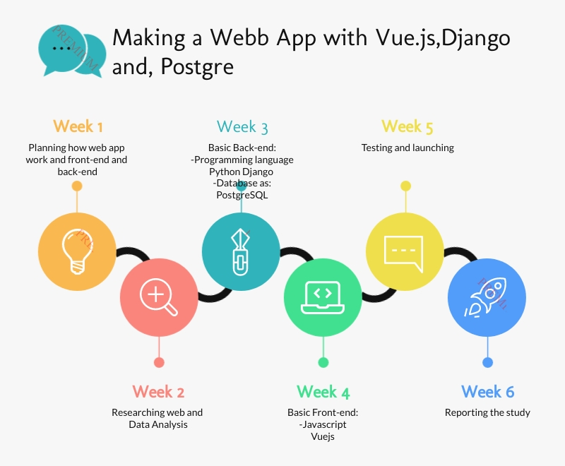



Roadmap

Slide 16
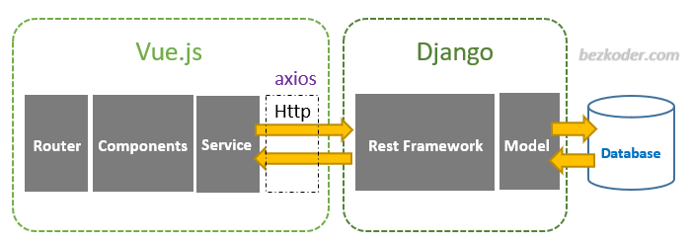
Interop logic of Vuejs, Django and PostgreSQL
The models created in the application created in Django are dragged into the postgre database by migration. Here, the dragged models are formed as tables in the database. (If desired, the operability of the database can be checked with the get method using postman.) Afterwards, components in vuejs to be used for frontend are created, and the router and the components here are connected to each other. Then, to connect vuejs and django, using django's API_URL, database connection is provided by using this API_URL in methods inside the components.

Slide 17
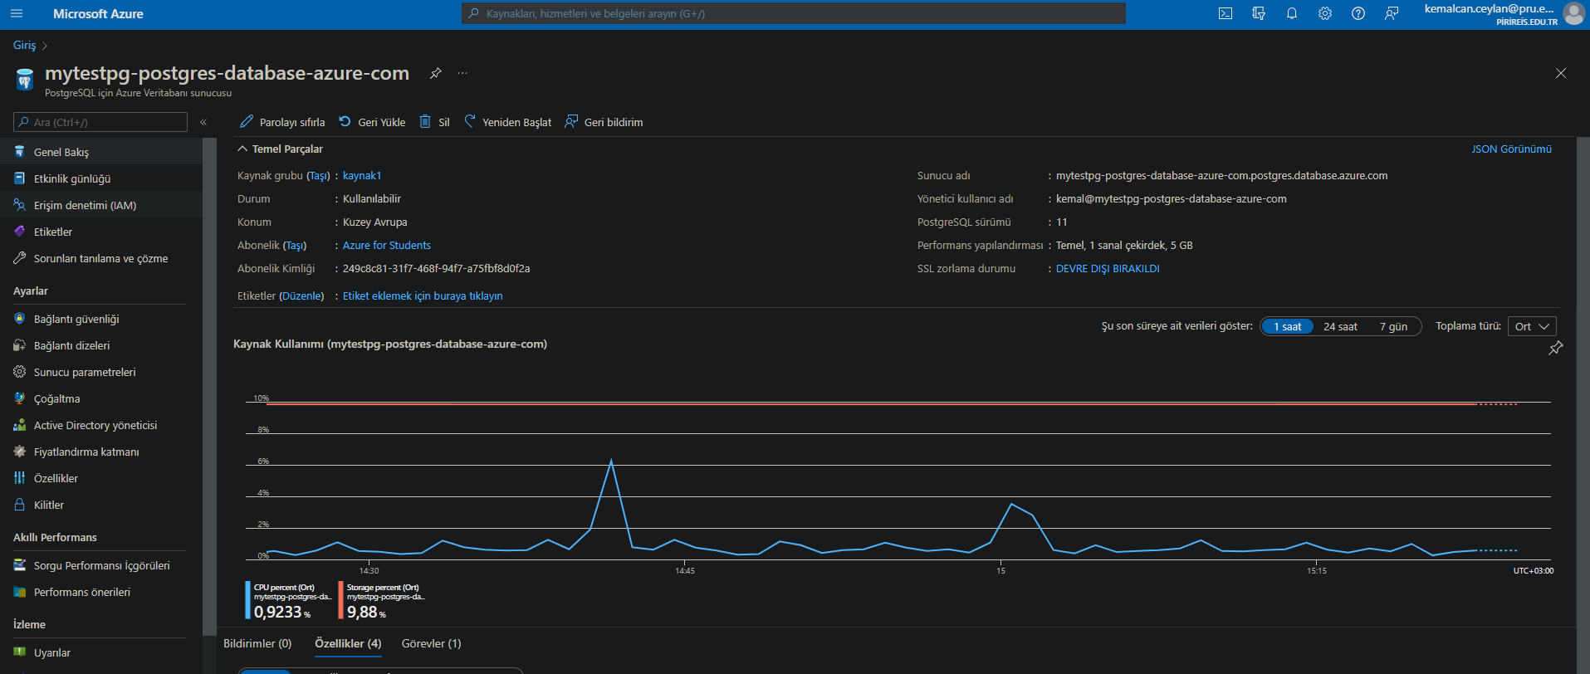
About Project
Azure host

Slide 18
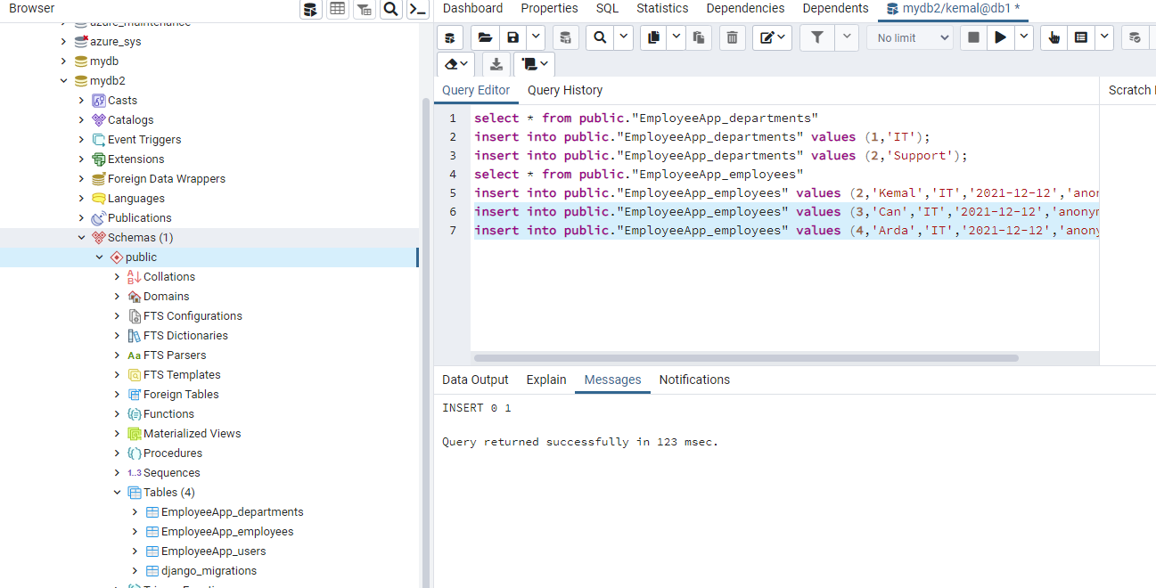
Database

Slide 19
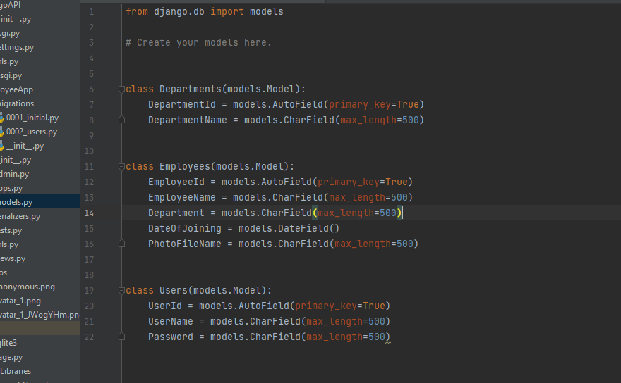
Django
The file seen in the picture is the models.py file that we sent into the database through migration and turned it into a table.

Slide 20
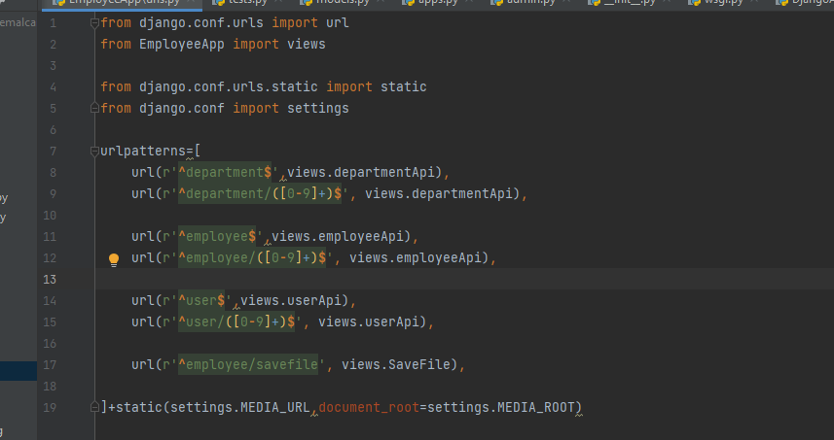
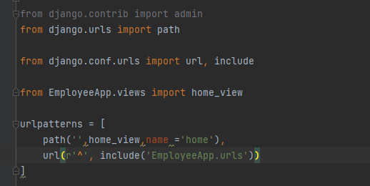
Django
Django will redirect everything that comes to 'http://127.0.0.1:8000/' to EmployeeApp.urls and look at the directives there.

Slide 21
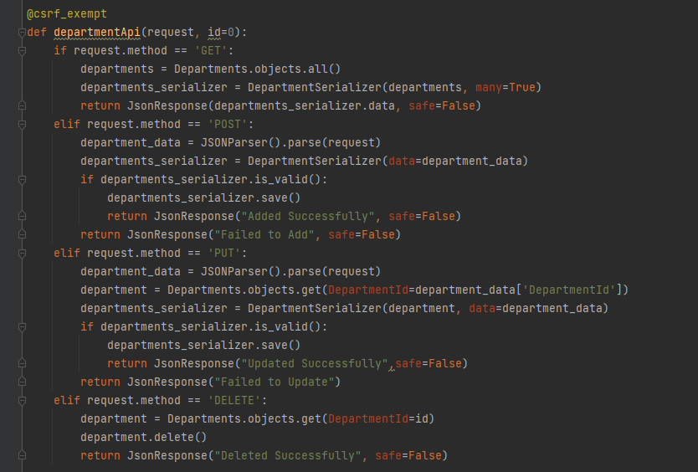
Django
Views.py is where the "logic" of our app is expressed. It takes information from the model we created before and transmits it to the template.

Slide 22
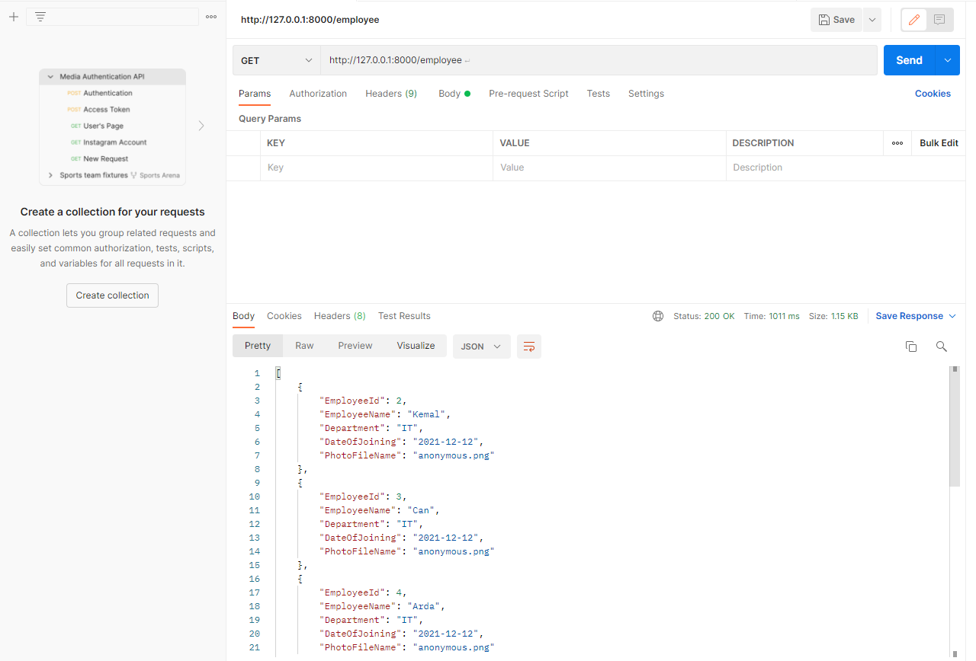
Postman
The operability of the tables sent from django via models is tested in the database, by using the Postman application.

Slide 23
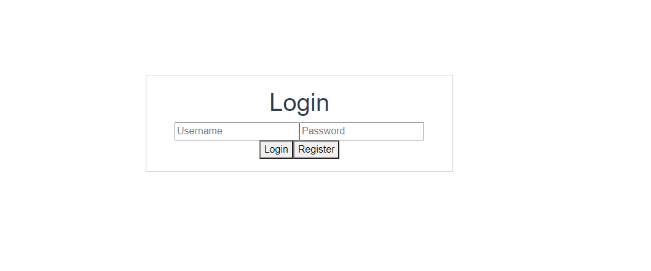
Login Page

Slide 24
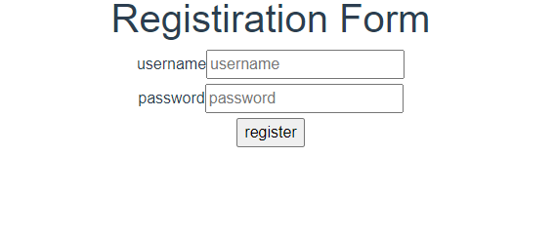
Registration Page

Slide 25
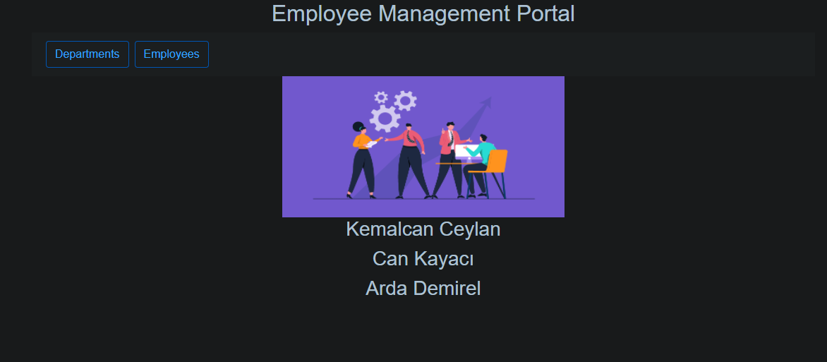
Main Page

Slide 26
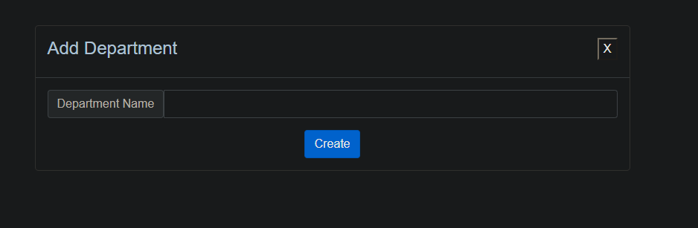
Add Department

Slide 27
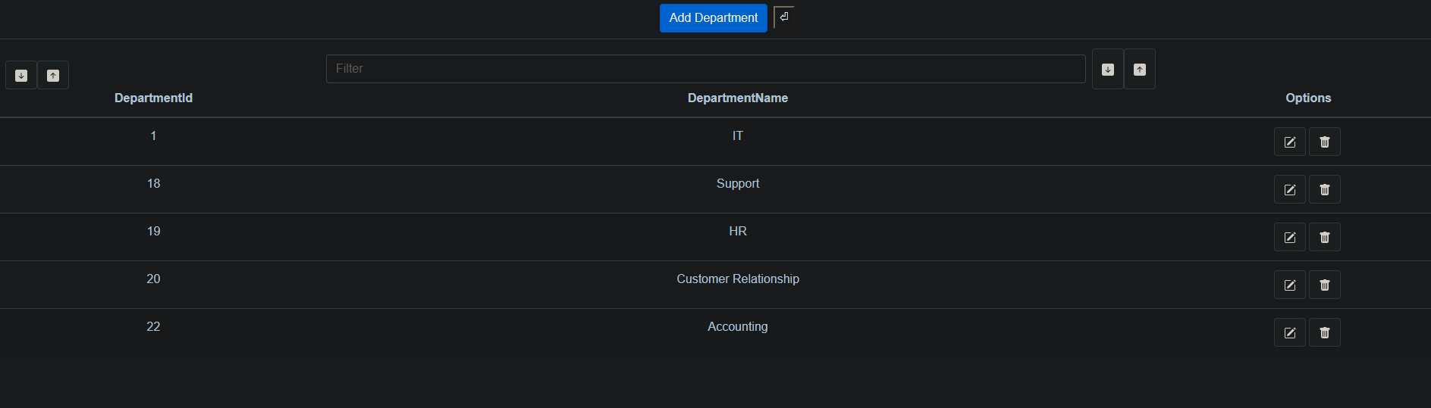
Departments Page

Slide 28
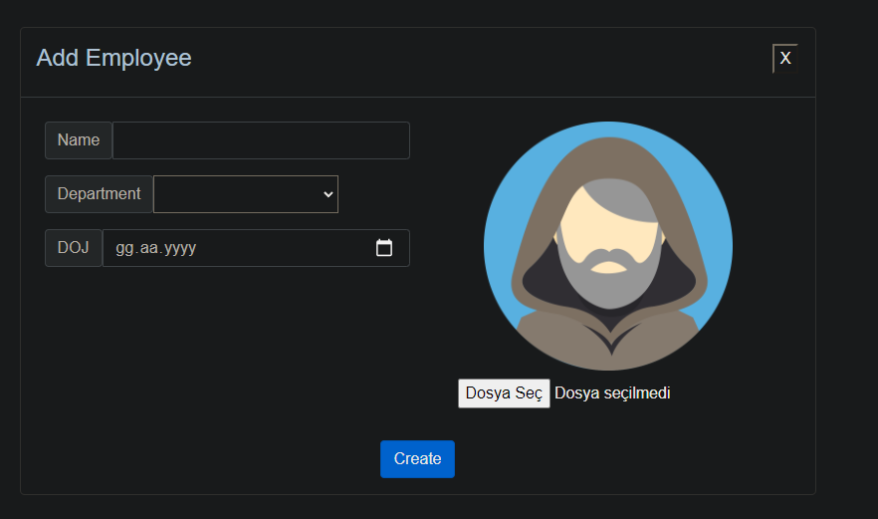
Add Employee

Slide 29
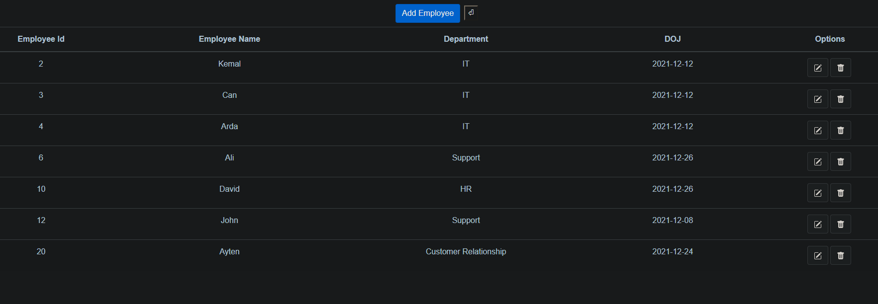
Employees Page

Slide 30
THANK YOU.

